Slide 1
Flower Guessing Game
Pinky Nelson

Slide 2


Agenda
A
Description
Reference/Links used
Customization I Made
List of What I have learned
Video Demonstrations
Screenshots of code Blocks&comments

Slide 3
Description
The Flower Guessing Game is a straightforward interactive Python game in which the player attempts to identify a flower that the computer has randomly selected. In the game, the user is prompted to choose a flower from a list, receive a welcome message, and then select one. After the user's input has been verified, the computer repeats its selection. The game's outcome is shown, letting the user know if their guess was correct or not. After a successful guess, the game offers feedback and a congrats message, allowing for a maximum of three attempts. This project provides a basic introduction to user input validation, randomization, and interactive Python programming..

Slide 4
Reference

Slide 5
Reference/Links used
https://www.youtube.com/watch?v=8ext9G7xspg&t=414s – Youtube
https://www.youtube.com/watch?v=rGo4oBY9_9U –Youtube
https://www.youtube.com/watch?v=AMhFET1yppQ –Youtube
https://www.w3schools.com/python/python_conditions.asp -w3schools

Slide 6
Points on Customization I Made

Slide 7
Points on Customization I Made
Name of the Game and Data Variations- Changed number guessing game to flower Guessing game.
Function Definitions -This code introduces several functions (`togetwelcomemessage`, `togetuserchoice`, `togetcomputerchoice`, `togetdisplayresult`, and `flowerguessinggame`). This modularizes the code, making it more organized and easier to maintain.
User Input Validation - This code (`togetuserchoice` function), a `while True` loop is used for continuous input until a valid choice is provided. It provides feedback for an invalid choice, making the game more user-friendly.
Maximum Attempts and Loop Control- This code includes a `for` loop with a set number of maximum attempts ( which is 3 I had given )in the `flowerguessinggame` function. It shows simple way to manage the number of attempts.

Slide 8
Points on Customization I Made
Feedback and Results - This code includes a feedback message indicating the number of attempts remaining and informs the user if they have won or lost. It also displays the correct answer if the user exhausts all attempts.
Importing Modules- This code explicitly imports the `random` module at the beginning.
Thank You Message- This code includes a "Thank you for playing! Come again!" message at the end, adding a polite closure to the game.
Structural Changes- This code separates the main logic into functions, improving code readability and maintainability.
Variable Names- I have changed each variable name according to the function of the code blocks.

Slide 9
List of what I have learnt doing this project

Slide 10
List of what I have learnt doing this project
Function Definition and Usage- I learned how to define functions (`togetwelcomemessage`, `togetuserchoice`, `togetcomputerchoice`, `togetdisplayresult`, and `flowerguessinggame`).Understanding the purpose of breaking down the code into functions for modularity and reusability.
User Input Handling and Validation- I learned how to take user input (`input` function) and validate it to ensure it meets certain criteria (checking if the user's choice is in the list of available flowers).
Randomization-I used the `random.choice` function to simulate the computer's choice randomly from the list of flowers.
Looping and Iteration-I used a `for` loop to manage the game flow and iterate a specific number of times (maximum attempts ).I used a `while True` loop for continuous user input until a valid choice is provided.

Slide 11
List of what I have learnt doing this project
String Manipulation- I utilized string manipulation methods, such as converting user input to lowercase (`lower()` method).
Control Flow with If Statements- I implemented if statements to check conditions (if the user's choice matches the computer's choice) and control the flow of the program accordingly.
Error Handling- Applying fundamental error-handling strategies to handle unforeseen problems or inputs.
Comments and Documentation- Creating documentation and comments to describe the code's functionality and goal.
Organization of the Project-Arranging the project's files and folders in a systematic manner. Separating the various concerns in the code in a clear manner.
Project Presentation-Creating slides, breaking down code snippets, and demonstrating a live demo.
Variable Naming- I practiced good variable naming conventions, choosing descriptive names like `userchoice`, `computerchoice`, and `maxattempts` to enhance code readability.
Project Structure- You learned how to structure a simple project with multiple functions and a main game loop.

Slide 12
ScreenRecording
that showing my project ran in an Interface

Slide 13


Slide 14
Screenshots
Code blocks used with comments

Slide 15
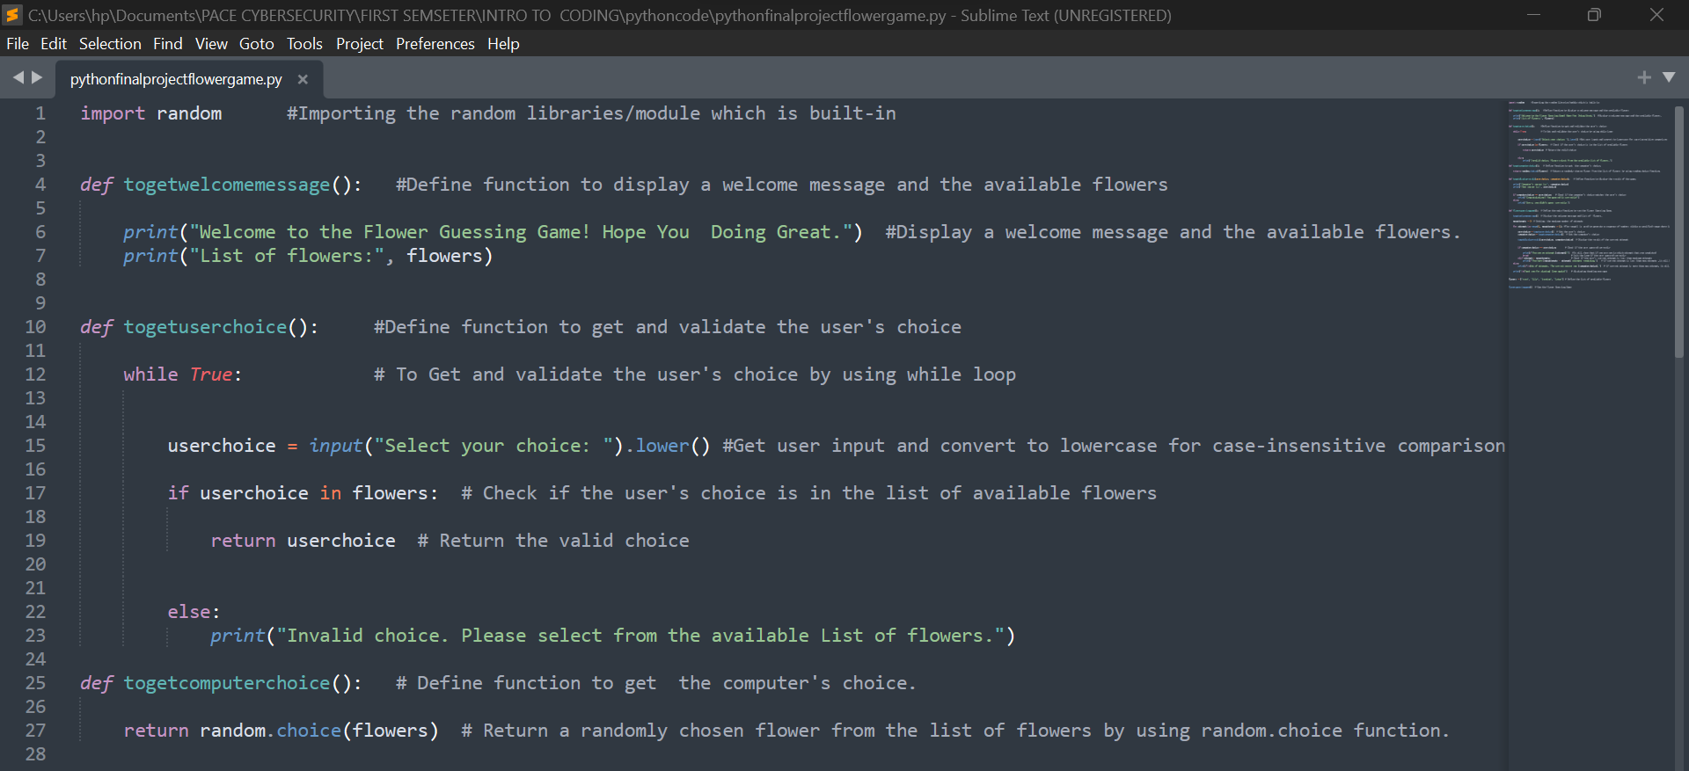

Slide 16
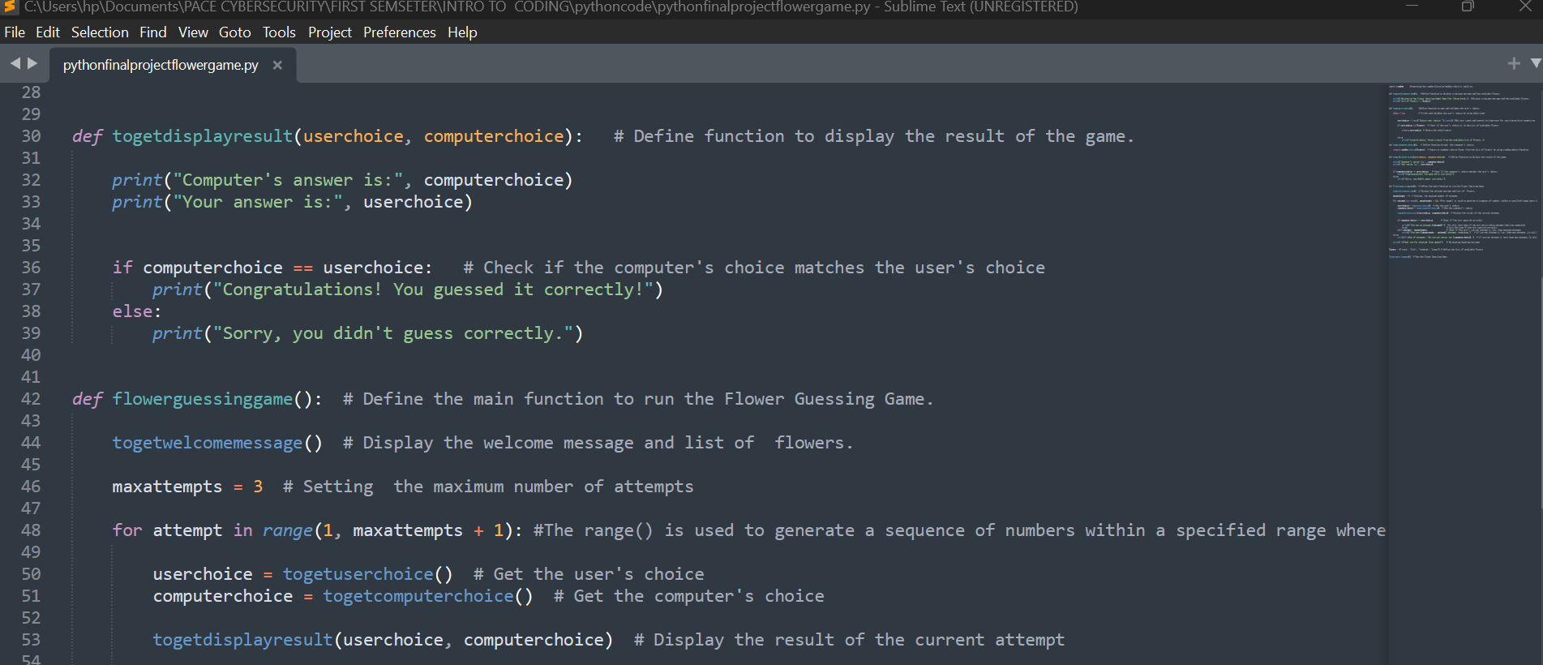

Slide 17
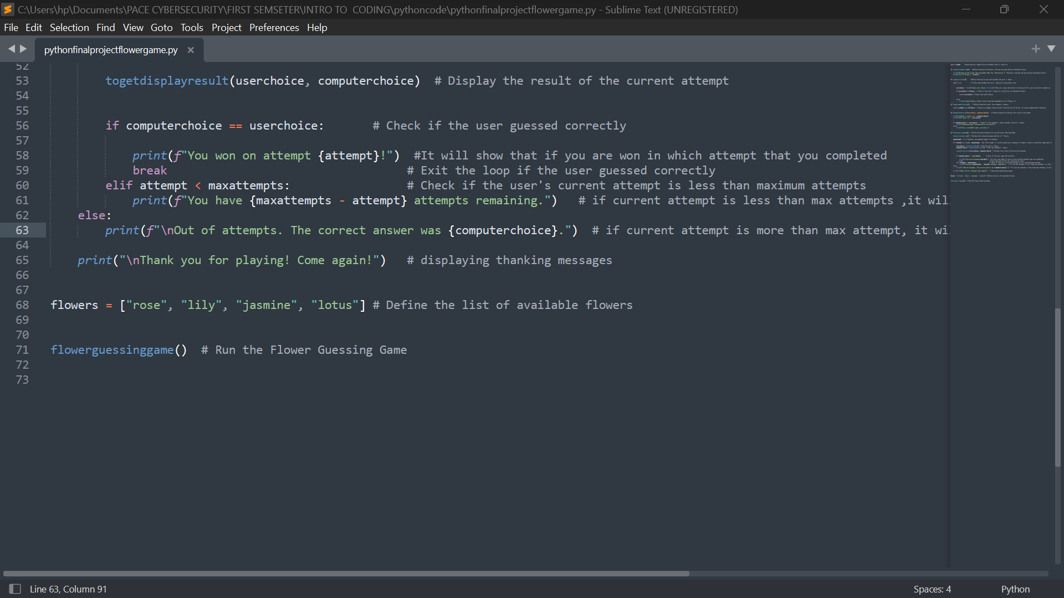

Slide 18
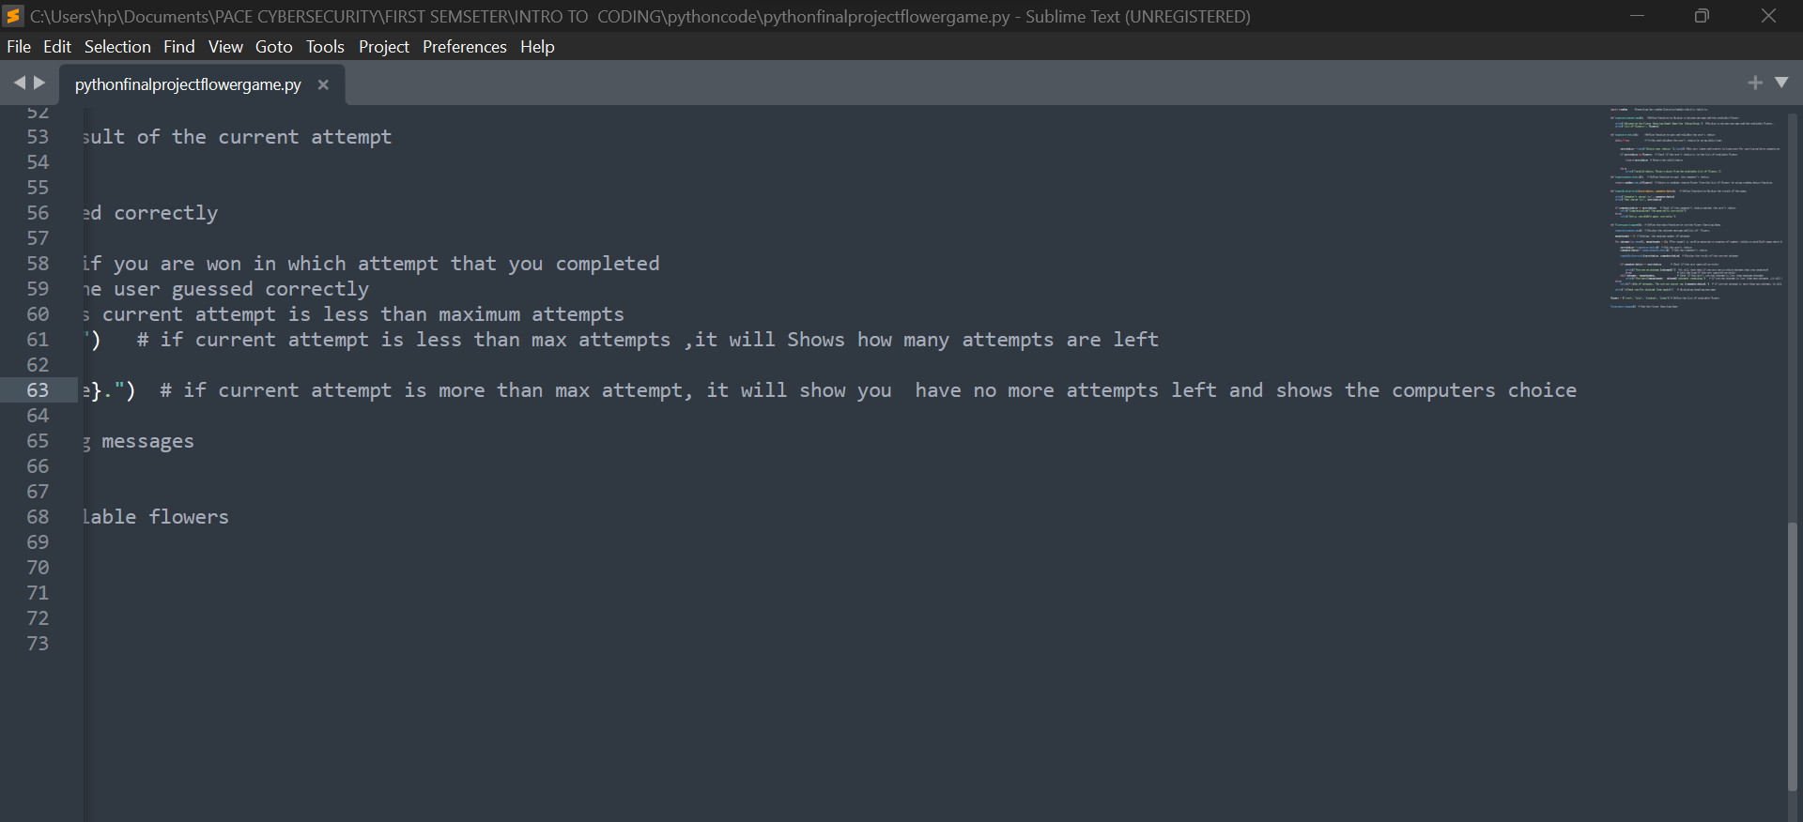

Slide 19
Thank you
PINKY NESLON
PN70516N@pace.edu

